Slide 1
Networking
By: Akanksha Sharma

Slide 2
Contents
Network Introduction
General Terms
Types of Network
Network Topologies
Internet
Protocols
OSI Layer
Network Components

Slide 3
What is Network?
It is the collection of devices like computers, servers etc. connected to one another to allow sharing of data.
The devices are connected using wired media like copper cables or wireless media such as Wi-Fi.

Slide 4
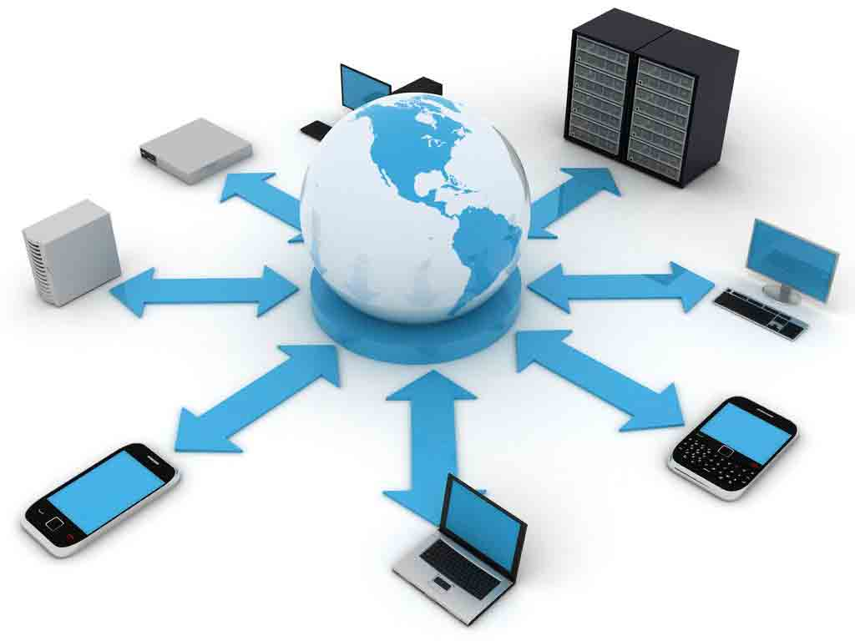
Continue…
A Computer Network facilitates user to communicate to another user using various facilities like email, instant messaging, video calls etc.

Slide 5
General Terms
Node or Host : Any device connected to the network.
Data Transfer Rate : The rate at which data travels from one place to another in the network.
Client : The node which initiates the request.
Server : The device which gives response to the particular request.

Slide 6
Types of Networks
LAN (Local Area Network)
WAN (Wide Area Network)
MAN(Metropolitan Area Network)
LAN : Computer Network that interconnects computer within a limited area such as residence , school , laboratory or office building.

Slide 7
Continue…
WAN : A network which extends over a large geographical distance. For Example: Internet
MAN : A network which interconnects users in a geographic region of the size of the metropolitan area .

Slide 8
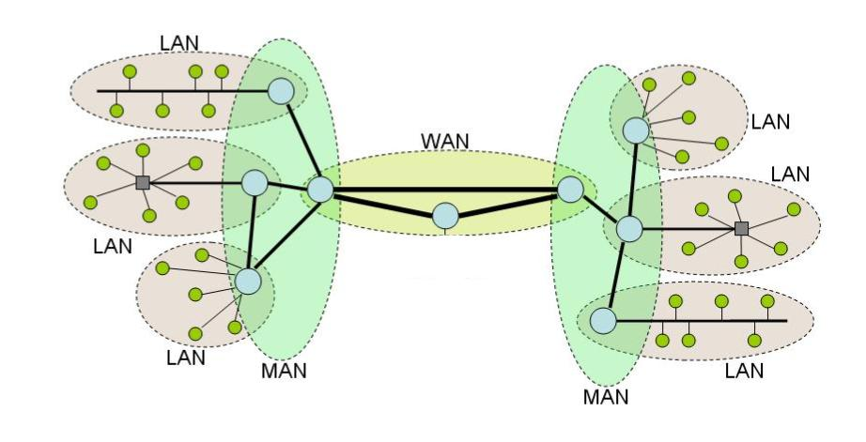

Slide 9
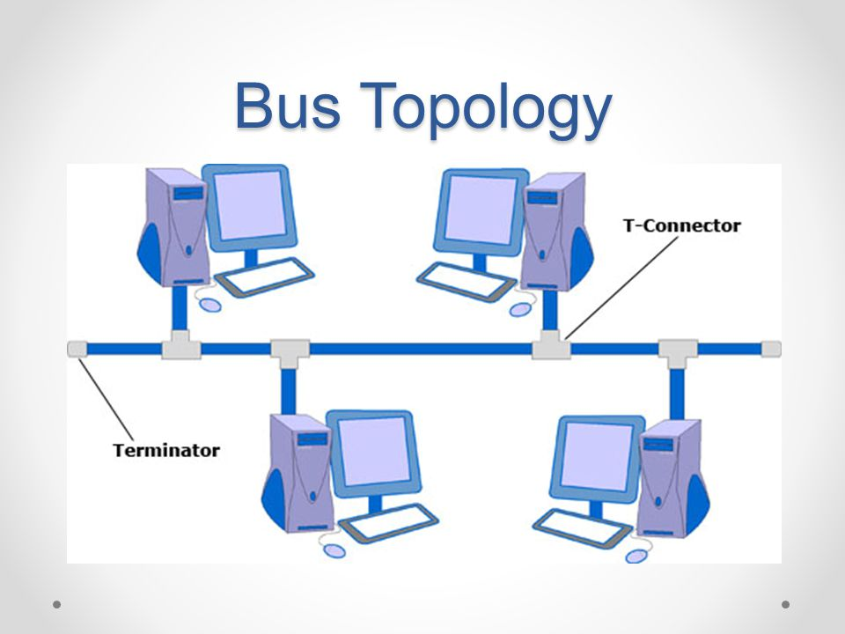
Topologies
Bus Topology: All nodes are connected to a single communication line that carries messages in both directions.
Notes:
It is applicable in home offices or small offices.

Slide 10
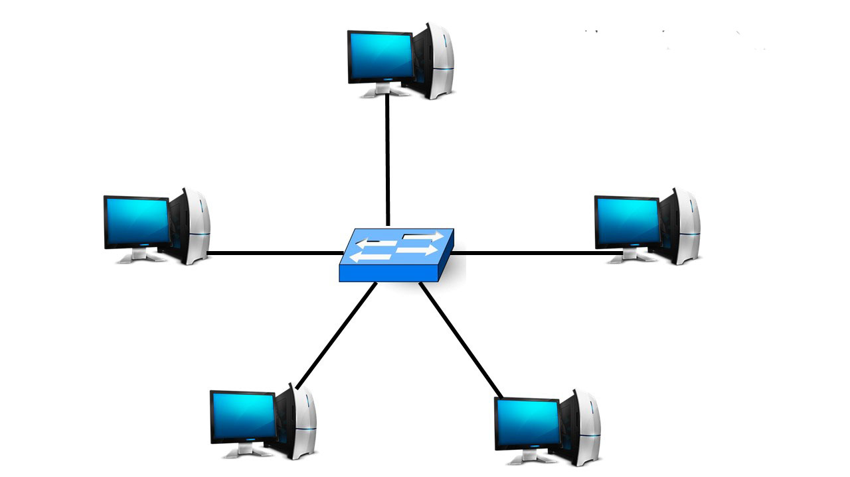
Topologies Continue…
Star Topology : A configuration that centers around one node to which all others are connected and through which all messages are sent.
Notes:
It is being used in large enterprises as one node dysfunction doesn’t hamper other’s work.

Slide 11
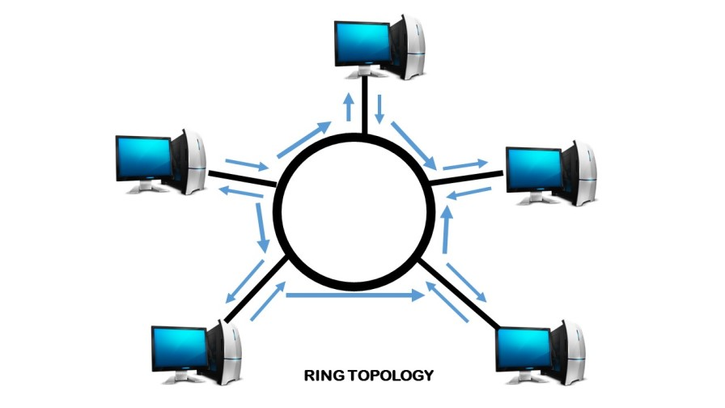
Topologies Continue…
Ring Topology : A configuration that connects all nodes in a closed loop on which messages travel in one direction.
Notes:
Most common example is IBM token Ring , which uses token to give privilege to the node for sending the data.

Slide 12
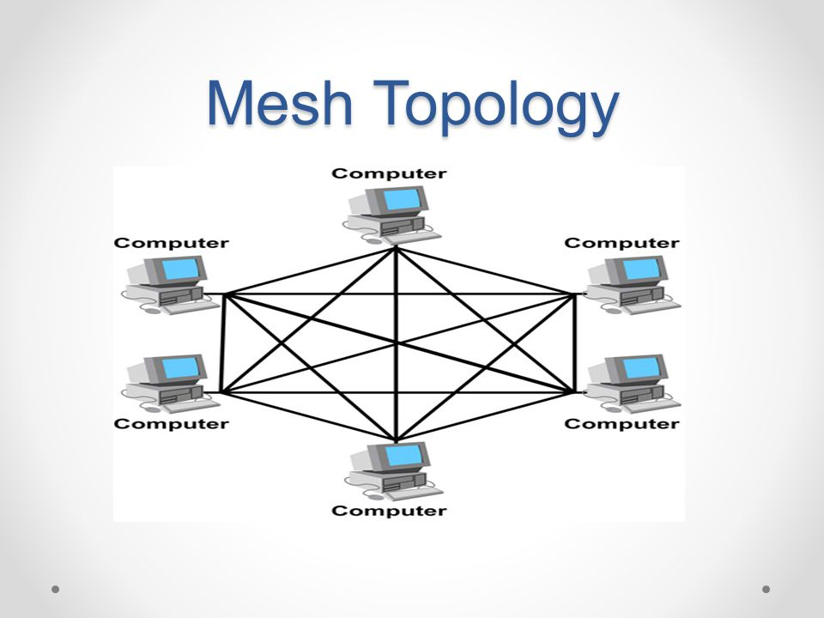
Topologies Continue….
Mesh Topology : It is a type of networking where all nodes cooperate to distribute data amongst each other.
Notes:
It is being used mainly as it provides redundancy as well as load balancing.

Slide 13
What is Internet?
The Internet is the global system of interconnected computer networks that use the Internet protocol suite (TCP/IP) to link devices worldwide.
The Internet is a global network that comprises many voluntarily interconnected autonomous networks. It operates without a central governing body.

Slide 14
Protocols
Protocol stands for set of rules.
The two models that are being followed to standardized the architecture of the communication over the internet are :
OSI Model (Open System Interconnect)
TCP/IP Model (Transmission Control Protocol/Internet Protocol)

Slide 15
OSI Model
International Organization for Standardization( ISO) has given this architectural model for standardization.
It is a concept of seven layer model designed by Charles Bachman at Honeywell Information Systems.

Slide 16
OSI Model
It is the concept of 7 layers.
Physical Layer
Data Link Layer
Network Layer
Transport Layer
Session Layer
Presentation Layer
Application Layer

Slide 17
Physical Layer
This layer is responsible for transmission and reception of unstructured raw data between a device and physical transmission medium.
It converts the digital bits into electrical, radio or optical signals.
Layer specifications define characteristics such as voltage levels, the timing of voltage changes, physical data rates, maximum transmission distances, modulation scheme, channel access method and physical connectors.

Slide 18
Data Link Layer
The data-link layer provides node to node data transfer-a link between directly connected nodes.
It detects and corrects the error that occurred in the physical layer.
It works on MAC address also known as Physical address contains 48 bits.
IEEE 802 divides this layer into two sub layers:
MAC Layer(Medium Access Control)
LLC Layer(Logical Link Control)
Notes:
MAC Layer is responsible for controlling how devices in a network gain access to a medium and permission to transmit data.
LLC Layer is responsible for identifying and encapsulating network layer protocols and error checking and frame synchronization.

Slide 19
Network Layer
The network layer provides means of transferring variable length data sequences (called packets) from one node to another connected in "different networks".
This layer works on IP addresses.
We have two versions of IP addresses IPv4 and IPv6.

Slide 20
Transport Layer
The transport layer controls the reliability of a given link through flow control, segmentation/desegmentation , and error control.
Segmentation is the process of dividing a long message into smaller messages.
TCP and UDP Protocols are the layer 4 protocols.

Slide 21
Session Layer
It establishes, manages and terminates the connections between the local and remote application.
The three modes of operation are simplex, half duplex or simplex.
Example for Simplex is Radio Broadcast, for Half Duplex is Police Wireless, for Full Duplex is Mobile Communication.

Slide 22
Presentation Layer
The presentation layer transforms data into the form that the application accepts.
This layer formats data to be sent across a network. It is sometimes called the syntax layer.

Slide 23
Application Layer
The application layer is the OSI layer closest to the end user, which means both the OSI application layer and the user interact directly with the software application.
Examples are : Telnet, FTP, TFTP, SMTP,DNS.

Slide 24
Network Components
Hub: A Hub is a hardware device that divides the network connection among multiple devices.
When computer requests for some information from a network, it first sends the request to the Hub through cable. Hub will broadcast this request to the entire network. All the devices will check whether the request belongs to them or not. If not, the request will be dropped.

Slide 25
Network Components
Switch : A switch is a hardware device that connects multiple devices on a computer network.
Switch delivers the message to the correct destination based on the physical address present in the incoming message. A Switch does not broadcast the message to the entire network like the Hub.
Switch works at layer 2 and layer 3.

Slide 26
Network Components
Router : A router is a hardware device which is used to connect a LAN with an internet connection. It is used to receive, analyze and forward the incoming packets to another network.
A router works at Layer 3 (Network layer) of the OSI Reference model.

Slide 27
Network Components
Cables and Connectors : Cable is a transmission media used for transmitting a signal.
There are three types of cables used in transmission:
Twisted pair cable
Coaxial cable
Fibre-optic cable

